Slide 1
Temporal Logics, Finite State Transition System and Model Checking
S. Ramesh
S. Ramesh

Slide 2
Embedded Software
Embedded systems consists of
  concurrent processes
  processes have their own speeds (clocks)
  Communicate for achieving system-wide goals
  Mutexes, message based communication
Our focus here is on
  finite state concurrent systems
  Embedded controllers
  abstract designs of real infinite-state systems
S. Ramesh

Slide 3
Alternating Bit Protocol
active proctype Sender ()
{ bit seq_out, seq_in;
do
:: to_rc!msg (seq_out) →
to_sc?ack (seq_in);
if
:: seq_in == seq_out →
seq_out = !seq_out
:: else → bug = 1
fi
od
}
active proctype Receiver ()
{ bit seq_in;
do
:: to_rc?msg (seq_in) →
to_sc!ack (seq_in)
:: timeout →
to_sc!ack (seq_in)
od
}
S. Ramesh

Slide 4
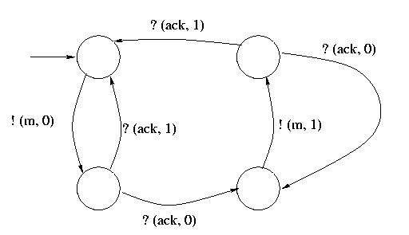
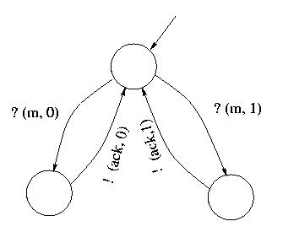
Pictorial Description
Sender Receiver
S. Ramesh

Slide 5
Verification
Embedded Systems are complex
  concurrency, asynchrony
  absence of global clocks
  failures:
    loss of messages, message reordering, message replication
    message corruption (byzantine problem)
    Processes can fail
Various errors
  deadlocks, race conditions
  channel overflow, wrong order of messages
  unsolicited messages, wrong messages
S. Ramesh

Slide 6
Testing inadequate
Case for formal verification is very strong
  testing is totally inadequate
  every run may be unique - goes through different sequence of states
  Systems are non deterministic and different runs take different paths
  Irreproducibility of bugs
  verification that checks all runs essential
S. Ramesh

Slide 7
Formal Verification
Three-step process
  Formal Specification
  Formal Models
  Rigorous Verification Procedure
Our focus here on finite state systems
  Fixed finite no. of processes
  Finite states for each process
  communication channels are bounded
Verification of finite state systems
  much easier than infinite state sequential programs
  automatic verification possible
  Model-checking
S. Ramesh

Slide 8
Origin of protocol verification
Protocol analysis of the 70s
  Dead-lock analysis,
  Absence of unsolicited messages
  Liveness analysis
Protocol verification in the current days
  generalization of this
  Verification of general properties
  Includes the above analysis
S. Ramesh

Slide 9
Formal Specification
Explicit specification of systems requirements and environmental constraints
Clear, unambiguous, consistent and complete specifications
Specification independent of design
  pre-design activity
Right specification leads to right design
State what rather than how
S. Ramesh

Slide 10
Reactive Systems
Specification in terms of External interfaces
Embedded systems are reactive systems
  reacts to external stimuli
  keeps ongoing interaction with the environment
  termination is a bad behaviour
S. Ramesh

Slide 11
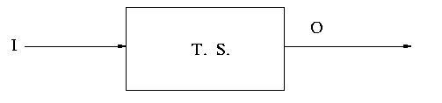
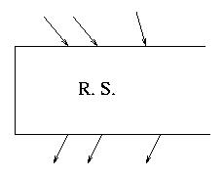
Models of Reactive Systems
Contrast with conventional systems which are transformational systems
S. Ramesh

Slide 12
Illustration
System Properties:
Safety: Nothing bad happens
S1: Every received message is sent
S2: Received messages are in order
S3: Ack. message sent only if the message is
received
Liveness: Eventually good happens
P1: Every sent message is eventually received
P2: Messages are received in order
P3: Eventually ack. messages are sent and received
Environment Constraints: (both safety and liveness)
C1: No infinite loss of messages
C2: No reordering of messages
C3: No corruption of messages
S. Ramesh

Slide 13
Temporal Properties
Properties and Constraints are temporal in nature
  Always, Eventually, Infinitely often
They specify permissible behaviours
Behaviours are infinite runs (reactive systems)
We need finitistic representation of such infinite objects for precision
Two Major formalisms:
  Symbolic Logics: Linear and Branching Temporal Logics,
    Linear Temporal Logic (LTL)
    Computational Tree Logic (CTL)
  Büchi Automata
S. Ramesh

Slide 14
Temporal Logics
Logics well-known for precise specification,
amenable to symbolic manipulations
used in a variety of contexts:
  Propositional Logic / boolean algebra for combinational HW
  Predicate logics for software
  Higher order logics for language semantics.
  Temporal logic for hardware, protocols and finite state embedded controller
Qualitative temporal statements
Examples:
  If it is cloudy, eventually it will rain
  It never rains here
S. Ramesh

Slide 15
Linear Temporal Logic
Syntax
Atomic propositions are formulae
If f, g are formulae then so are
  ¬f, f ∧ g, f ∨ g, f → g, f ↔ g (state formulae)
  □ f – Henceforth f (box f)
  ◊ f – Eventually f (diamond f)
  f U g - f until g
  f W g - f unless g
  Οf - next f
state formulae - no temporal operators
S. Ramesh

Slide 16
Semantics
Formulae correspond to sets of infinite sequences of states
Every atomic formula corresponds to a state of valuation of variables that satisfy the formula
Let σ = q₀, q₁ , … be a sequence
  In each q_{i}, certain atomic propositions hold
Semantic definition states precisely when a state sequence is in the set corresponding to a given formula
The definition is inductive on the structure of the formula
S. Ramesh

Slide 17
Notation
Given a state sequence σ and a formula Α
σ ╞ A
stands for the fact that σ is in the set corresponding to the formula A
σ ╞ A iff (σ ,0)╞ A
(σ , j) ╞ A - defined inductively
Base case:
(σ , j) ╞ f for any state formula f iff f holds in
the state σ [j]
S. Ramesh

Slide 18

Semantics of Temporal Operators
(σ , j) ╞ Ο f iff (σ , j + 1) ╞ f
S. Ramesh

Slide 19

Semantics Contd.
(σ , j) ╞ □f iff ∀k≥ j, (σ, k) ╞ f
S. Ramesh

Slide 20

Semantics Contd.
(σ , j) ╞ ◊f iff ∃k ≥ j, ( σ ,k) ╞ f
S. Ramesh

Slide 21

Semantics Contd.
(σ , j) ╞ f U g iff ∃k ≥ j : (σ, k)╞ g and
∀i s.t. j ≤ i < k, (σ , i)╞ f
S. Ramesh

Slide 22
Semantics Contd.
(σ , j) ╞ f W g iff (σ , j) ╞ f U g or
(σ , j) ╞ □ f
S. Ramesh

Slide 23
Examples
p → □q
If p holds in the beginning then q holds always
□(p → ◊ q)
Whenever p holds there is a future instant in which q holds
□ ◊ p
p holds infinitely often
◊ □ p
p holds at all but finitely many positions
S. Ramesh

Slide 24
Examples - Properties
□¬(sent_0 ∧ sent_1)
□ (sent_0 → ◊ recd_0)
□ (sent_0 → ◊ ack_0)
□ (sent_0 → sent_0 W ack_0)
□ (sent_0 → sent_0 U recd_0)
S. Ramesh

Slide 25
Büchi Automata
An alternate formalism for specifying infinite objects
Extension of Finite Automata to specify properties about infinite runs (sets of infinite runs)
The simplest kind is Büchi automaton:
< Q, Σ, →, q₀ , A >
Q - finite no. of states
Σ - Edge labels
q₀ - initial state
→ ⊆ Q x Σ x Q
A ⊆ Q, Accepting (not final) states
S. Ramesh

Slide 26
Behavior of Büchi Automata
starts from the initial state,
`runs forever'
accepts infinite sequences over label alphabet
s = l0, l1, l2, . . . is accepted by the automaton, provided there exists q₀, q₁,… s.t.
  (q_{i}, l_{i}, q_{i+1}) Є → for i = 0, 1, …
  there is an accepting state that occurs infinitely often in s.
S. Ramesh

Slide 27
Examples
1
0
0,1
All sequences containing only 1.
An infinite sequence of 1s
But finite description
S. Ramesh

Slide 28
Examples contd.
0,1
0,1
1
All sequences that have at least one occurrence of 1
00010000…, 10000…, 01000…, 1111000…, 1111…
S. Ramesh

Slide 29
Examples contd.
0,1
0
0
All sequences containing eventually only 0s
11110000…, 110000…, 000…, 1010100000…
S. Ramesh

Slide 30
Examples contd.
0,1
1
1
0
0
1
Sequences containing all but finitely many occurrences of 1s.
Alternatively, sequences containing infinitely many 1s
1111…, 101111…, 000111…, 101010101100011…, 10101010…
S. Ramesh

Slide 31
Features of Büchi automata
useful for specifying properties and constraints
precise and unambiguous
consistency can be checked (Emptiness of automata)
has many properties useful for verification:
  closed under union, intersection and complementation
Close correspondence between LTL formulae and Buchi automata
  Buchi automata are more expressive
S. Ramesh

Slide 32
Formal Models
Need for abstract and formal models
  Precise and unambiguous
  Consistent and Complete
Formal Verification
  applies to mathematical models
  not to real objects
  hence called design model verification
  Faithful models essential
    False negatives (spurious errors)
    False positives (models pass - system fails)
Simulation/Testing can not be dispensed with
S. Ramesh

Slide 33
Formal Modeling Languages
Employed by verification tools and methods
enable abstract and high level descriptions
Real languages often ambiguous
variation in HDL semantics
Real languages require more details and effort
Features
Limited and High Level Data Types
Non determinism (arising out of abstractions)
Concurrency (to structure large systems)
Communication (for internal and external interaction)
Fairness (abstraction of real concurrency and schedulers)
S. Ramesh

Slide 34
Modeling Languages
Tool-specific
  Promela (Spin), SPL (STeP), CSP, CCS (concurrency workbench)
  Esterel, CFSM (embedded controllers)
  Statecharts, UML (System level models)
  Stateflow (Matlab)
Formal models
  Beside verification, useful as design languages and for code generation
Underlying model: State-Transition System Models
S. Ramesh

Slide 35
State Transition Systems
A system of state machines
Finite number of states
Edges connecting a pair of states
Edges optionally labeled with communication actions
Edge labels indicate communication with other state machines
A single state machine describe the behavior of a process
The behavior of the entire system is modeled as concurrent composition of individual state machines
  asynchronous composition with
  One step from each process
  Some steps possibly synchronized
A single transition system that models the global behavior of the whole system
S. Ramesh

Slide 36
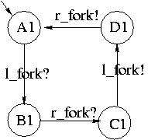
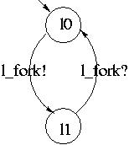
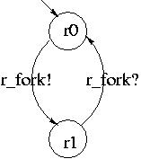
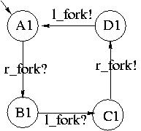
Dining Philosophers
S. Ramesh

Slide 37
Global Automaton
(A₁, A₂, l₀, r₀)
(B₁, A₂, l₁, r₀)
(A₁, B₂, l₀, r₁)
(C₁, A₂, l₁, r₁)
(A₁, C₂, l₁, r₁)
(D₁, A₂, l₀, r₁)
(A₁, D₂, l₁, r₀)
(B₁, B₂, l₁, r₁) deadlock
S. Ramesh

Slide 38
Semantics of Finite State Systems
The above description is syntactic
Association of behaviors
  Branching Time semantics
    the tree of states obtained by unwinding the state machine graph
    possible choices are explicitly represented
  Linear Time Semantics
    the set of all possible `runs' in the system
    the set of all infinite paths in the state machine
S. Ramesh

Slide 39
Formal Verification
Once we have formal specification and a system model, we are ready for verification
Rigorously verifying that
  the given properties are satisfied by the system model
Properties given as temporal logic formulae
Temporal logic specification specify properties of infinite runs
System model as collection of communicating state machines
Global state machine specifies a set of possible system runs
S. Ramesh

Slide 40
Verification
Verification involves checking that
  every infinite run of the system model satisfies the temporal properties
Specification includes environmental constraints
  Consider only those runs that satisfy the constraints
S. Ramesh

Slide 41
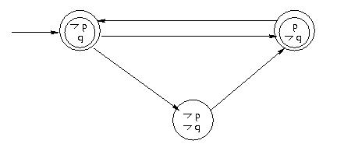
Illustration
Which of the following hold for all the sequences generated by the above
◊p, ◊¬q, □p, □ (p ∨ q)
◊(p ∨ q), ◊ (p ∧ q), □◊(p ∨ q),
◊ □p, (p → ◊q).
S. Ramesh

Slide 42
LTL Verification Method
Two related Methods:
  Tableau – based
  Automata – based
S. Ramesh

Slide 43
Automata based Method
  Obtain a Büchi-automaton for the negation of the formula
  Take the synchronous product of system model and the automaton
    Synchronous product is one in which every transition of the product requires transition from both the automata
  Check whether the resulting automaton accepts any string at all (Emptiness Check).
  Existence of an accepting cycle in the product graph
  If no cycle then original property holds.
  A cycle gives a counterexample - an execution trace that violates the formula; useful for debugging
S. Ramesh

Slide 44
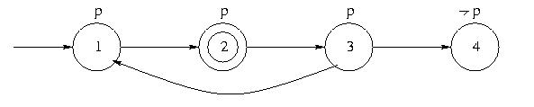
Example
The problem is to check whether the above automaton satisfies the formula □ p.
Assume that there is a self-loop at state 4.
S. Ramesh

Slide 45
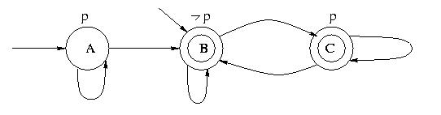
Example
Construct first a Büchi Automaton for ◊¬p, the
negation of □ p.
Accepting runs are exactly those where the formula holds
S. Ramesh

Slide 46
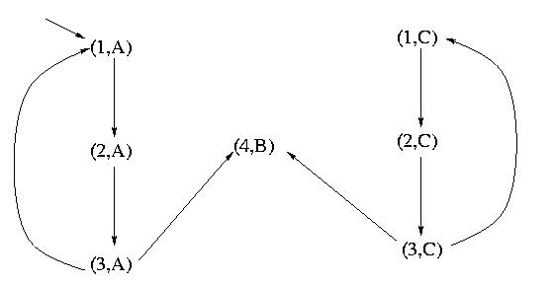
Example contd.
2. Construct the synchronous product of the two automata:
    Note many state pairs are missing
    No reachable accepting cycle
      Why?
    It is a model of □ p.
S. Ramesh

Slide 47
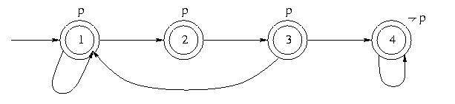
Another Example
Check whether the following automaton satisfies ◊□¬p
S. Ramesh

Slide 48
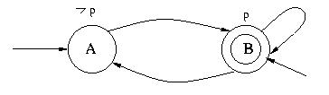
The Example contd.
Büchi Automata for : ¬( ◊ □ ¬p)
S. Ramesh

Slide 49
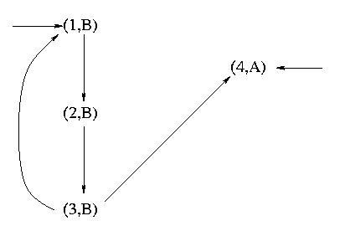
Product Automaton
  There is a cycle and hence the automaton is not a model
  If state 4 is the only accepting state then the formula holds
S. Ramesh

Slide 50
Complexity of model-checking
Polynomial on model size and exponential on formula size
Formulae are generally small!
Model size exponential on block size (no. of storage elements).
State Explosion Problem
S. Ramesh

Slide 51
Spin Tool
Home page:
    http://netlib.bell-labs.com/netlib/spin/whatispin.html
Bell Labs. (G. Holzmann)
Verification of asynchronous protocol descriptions
Modeling Language: PROMELA
Specification Language: LTL
Verification Approach: Automata Containment (Explicit Model Checking)
S. Ramesh

Slide 52
PROMELA
Protocol Modeling Language
Concurrent and non deterministic processes
Process communication: messages via buffered and non buffered channels
S. Ramesh

Slide 53
An Example
chan in = [size] of {short}
chan out1 = [16] of {short}
chan out2 = [16] of {short}
proctype split()
{short x
do :: in?x →
if :: (x >= 100) → out1!x
:: (x <= 100) →out2!x
fi
od
}
S. Ramesh

Slide 54
An Example
proctype merge()
{ short y
do :: if
:: out1?y
:: out2?y
fi;
out!y
od
}
init {run split(); run merge() }
S. Ramesh

Slide 55
Spin Features
Random Simulation, Deadlock detection and Formal verification
A clever implementation of model checking algorithm
  Nested depth-first search for cycles
  Clever hashing techniques
  Supertrace algorithm: bit state hashing
  On the fly model-checking
S. Ramesh

Slide 56
Nested Depth First Search
Algorithm discussed above is naive
  Full construction of Global Machine
  Construction of Büchi Automaton
  Computation of product graph
  Detection of cycles
Two depth first computation
  The global machine construction
  Cycle detection
Both can be combined
  Nested depth first computation
  As you construct, look for state repetition
S. Ramesh

Slide 57
On-the-fly Verification
No need for construction of the entire state machine
Nor the Büchi automaton, nor the product
The search can be terminated once a cycle is found
Spin algorithm interleaves the construction of product automaton with cycle detection
Even the global automaton is also constructed in an incremental manner
S. Ramesh

Slide 58
Counter-Examples
When a cycle found, the path from the initial state to the state at which the cycle is detected can be easily constructed
Thanks to the depth first search
  Just read the stack contents
Counter examples
Useful for debugging
One of the attractive features of model-checking
S. Ramesh

Slide 59
Bit-State Hashing
Spin is an explicit model-checker
Direct representation of states and state sets
Full representation exhaust the memory soon
Exhaustive analysis possible only for small designs
Partial search or more abstract designs essential
Partial search techniques:
  Random selection of successors, search up to finite depth, etc
Bit-State hashing
  One bit per state – each state hashed to one bit in memory
  If a bit set, the state assumed to be visited
  Claimed to give very good coverage of state space
S. Ramesh

Slide 60
Reduction Techniques
Global machine has a lot of interleavings
Make statements atomic wherever possible
  Local actions should be enclosed within atomic
Partial order reduction
  Powerful technique
  Identifies equivalent interleaved paths and generates and checks only representatives
  done by controlled selection of successors
S. Ramesh

Slide 61
Other techniques
Implicit representation of states and sets using Binary Decision Diagrams (symbolic representation)
Program Slicing
  Automatic reduction of the program
  Dependent upon the property being verified
Compositional Verification
  Decompose the program into parts
  Verify the parts and combine the results
S. Ramesh

Slide 62
Usage of the Tool
Used in Bell Labs.
Many telecommunication protocols verified
A large user base
Annual Conference on usage, extension and improvement of the tool
Open source (in C)
S. Ramesh

Slide 63
Computational Tree Logic (CTL)
CTL formulae describe properties of Computation Trees
Computation Trees are obtained by unwinding the transition system model
Branching structure due to nondeterminism
CTL is the simplest branching temporal logic
CTL* is more powerful, includes CTL and LTL

Slide 64
Syntax of CTL
Every atomic proposition is a CTL formula
If f and g are formulae then so are
  ¬f, (f ∧ g), (f ∨ g), (f → g), (f ↔ g)
  AG f - in all paths, in all states f holds (in all future f)
  EG f - in some path, in all states f holds
  AF f - in all paths, in some state f holds (in every future f)
  EF f - in some future, f holds
  A(f U g) - in all paths, f holds until g
  E(f U g) - in some path, f holds until g
  AX f - in every next state, f holds
  EX f - in some next state, f holds
Note every occurrence of G,F,X and U always preceded by A or E

Slide 65
Examples
AG ¬ (farm_go ∧ high_go_B)
AGAF (farm_car → AF(farm_go))
AG A(mem_wr U mem_ack)
EF E(req₀ U grant₀ )
Note every F,G, U preceded by A or E.

Slide 66
Automatic Verification
Model Checking and Language Containment
For finite state systems like hardware blocks, protocols and controllers.
Systems modeled as transition systems or automata
Specifications: Temporal formulae (LTL, CTL) or Automata
Verification:
  Model Checking: A finite state system or automaton satisfies a temporal logic specification iff it is a model of the formula.
  Language Containment: An automaton model (M) of the system satisfies an automaton specification (S) if the language of M is contained in that of S.

Slide 67
CTL model checking
(Clarke and Emerson, Quielle and Sifakis)
M╞ F
M: Transition System. and F: CTL formula
M defines a tree (unwind the Transition System)
F specifies existence of one or all paths satisfying some conditions
Verification involves checking whether these conditions hold for the tree defined by M

Slide 68
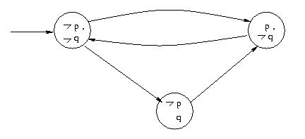
EXAMPLE
Which of the following hold ?
AG p, EF¬q, AX p, AG ¬q, EG ¬q, AX(p ∨ q)
How about AG AF p. EG EF p, EF AG q?

Slide 69
CTL Verification by Explicit Enumeration
Iterative labeling algorithm that labels all the states with sub formulae
Start from initial labels: atomic propositions
Iteratively add sub formulae as labels of each state based on the following equations:
EF p = p ∨ EX p ∨ EX(EX p) ∨ . . .
EG p = p ∧ EX p ∧ EX(EX p) ∧ . . .
E (q U p) = p ∨ (q ∧ EX p)
 ∨ (q ∧ EX(q ∧ EX p))
 ∨ . . .

Slide 70
CTL Verification
Iteration terminates since states and subformulae are finite.
If initial states of model are labeled with the given formulae then model checking succeeds
If it fails, counterexample can be generated

Slide 71
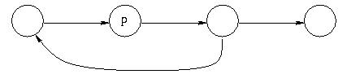
Illustration
To compute EF p which is:
  EF p = p ∨ EX(p) ∨ EX(EX(p)) ∨ . . .

Slide 72
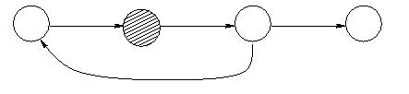
Illustration (contd.)
Iterative computation
I step :

Slide 73
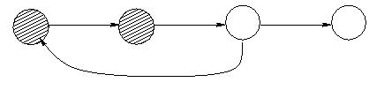
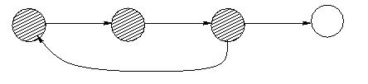
Illustration contd.
II step :
III step :

Slide 74
Illustration contd.
Computation terminates
EF p: Holds in all striped states
Computation involves backward breadth first traversal and calculation of Strongly Connected Subgraphs (cycles)

Slide 75
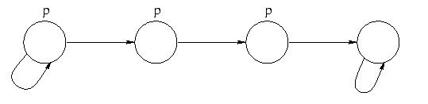
Computing EG p
EG p = p ∧ EX p ∧ EX(EX p) ∧ . . .

Slide 76
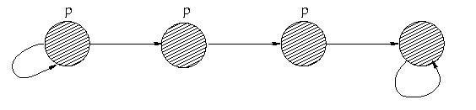
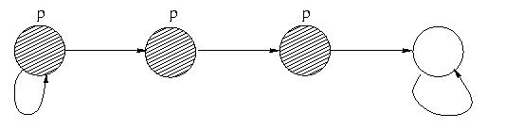
Illustration (contd.)
Start with
I iteration

Slide 77
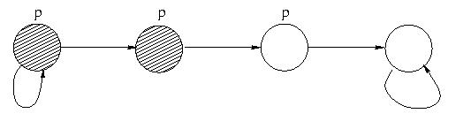
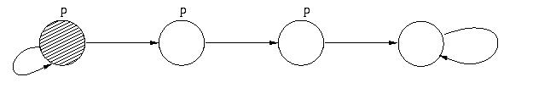
Illustration contd.
II iteration
III iteration
Iteration terminates

Slide 78
Complexity of CTL model checking
Algorithm involves backward traversal
Linear on sizes of both formula and model
Size of model: Exponential in number of latches
Reduction techniques:
  Symbolic model checking
  Compositional verification
  Symmetry based reduction

Slide 79
Temporal Logics
`Sometime’ is some times `not never’
  Famous paper by Leslie Lamport, Turing Awardee
Many Turing awards for temporal logic works
  Amir Pnueli, Ed Clarke, Emerson, etc.
LTL and CTL are limited
  Weak notion of time, discrete succession of events
  Atomic propositions are Boolean valued
Several extensions to LTL/CTL
  Temporal Logic of Actions TLA+
    used in Microsoft and Amazon
  First order and Real Time extension of Temporal Logics

Slide 80
Verification
by
Theorem Proving

Slide 81
Theorem Proving
Classical technique
Most general and powerful
Non-automatic (in general)
Idea
Properties specified in a Logical Language (SPEC)
System behavior also in the same language (DES)
Establish (DES → SPEC) as a theorem.

Slide 82
A Logical System
A language defining constants, functions and predicates
A set of axioms expressing properties of the constants, functions, types, etc.
Inference Rules
A Theorem
`follows' from axioms by application of inference rules
  Has a proof

Slide 83
Proof
Syntactic object
A₁, A₂, . . . , A_{n}
A₁: axiom instance
A_{n}: theorem
A_{i+1} - Syntactically obtainable from
A₁, . . . , A_{i} using inference rules.

Slide 84
Examples
Propositional logic and its natural deduction system
Prove Σ^{Ν}_{i=1} i = N(N + 1)/2, using Peano's axioms and mathematical induction

Slide 85
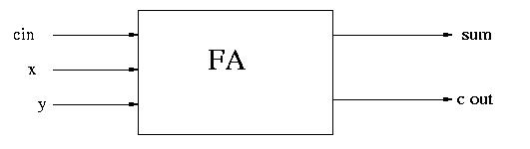
Full Adder
sum := (x ⊕ y) ⊕ cin
cout := (x ∧ y) ∨ ((x ⊕ y) ∨ cin)
Theorem: sum = x + y + cin – 2 * cout
Proof : Use properties of Boolean and arithmetic operators

Slide 86
Problems with this approach …
Verification is a laborious process
Manual proofs could contain error
If proof exists, system is correct;
  Otherwise, no conclusion.
Interactive Theorem Provers
Ease the process of theorem proving
Proof-Checking
Decision Procedures
Proof Strategies
Theory building
Many systems are available: Nqthm, PVS, HOL, Isabelle, etc.

Slide 87
Summarizing . . .
A rough sketch of landscape of formal verification
Formal specification states properties of system under verification using symbolic logic
  Assumptions and Assertions
Formal Modeling using State Transition System
  Focused on Finite state transition system
  Infinite state transition systems, in general
Formal Verification involves
  Algorithm Procedure ( Model checking ) for finite state systems
  Semi-decision procedure, in general
December 2006

